Slide 1
‘Every Teacher is a Teacher of Special Needs’
The role of SENCo
Policy and practice
Quality First Teaching
Identification
Strategies

Slide 2


Slide 3
The SENCO
The National Standards for Special
Educational Needs Coordinators (2014), sets out
four suggested areas of SEN coordination:
Strategic direction/ development of SEN provision in school
Teaching/learning
Leading and managing staff
Efficient/effective deployment of staff and resources
The key pieces of SEN legislation that SENCos must be familiar with are Part 3 of the Children and Families Act 2014 and the ‘SEND Code of Practice’ [2015] (‘CoP’), which elaborates on their legal requirements and provides guidance on education of children with SEND.

Slide 4
SENCos seek to develop, with the support of the headteacher and colleagues, effective ways of overcoming barriers to learning and sustaining effective teaching through the analysis and assessment of pupils’ needs, by monitoring the quality of teaching and standards of pupils’ achievements, and by setting targets for improvement.

Slide 5
Children’s and Families Act 2014
How the Act helps children and young people with special educational needs or a disability
It means simpler ways of assessing what children and young people need.
It means getting health and social care services to work together better.
And it means giving children and young people themselves, as well as their parents, more choices about the help they get.

Slide 6
SEN Code of Practice 2014
Special educational provision is educational or training provision that is additional to or different from that made generally for others of the same age. This means provision that goes beyond the differentiated approaches and learning arrangements normally provided as part of high quality, personalised teaching.

Slide 7
Special Educational Needs and provision is divided into 4 categories
1. Cognition and Learning
2. Social, Emotional and Mental Health
3. Communication and Interaction Needs
4 Sensory and Physical Needs

Slide 8
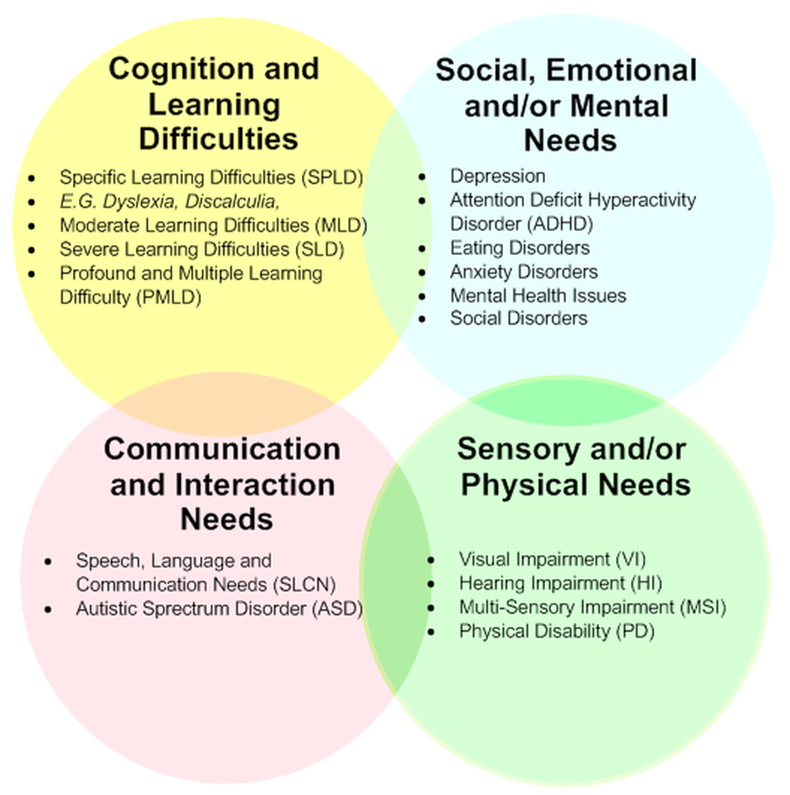

Slide 9
Special education provision in schools
Teachers are responsible and accountable for the progress and development of the pupils in their class, including where pupils access support from teaching assistants or specialist staff.
High quality teaching, differentiated for individual pupils, is the first step in responding to pupils who have or may have SEN. Additional intervention and support cannot compensate for a lack of good quality teaching.
The identification of SEN should be built into the overall approach to monitoring the progress and development of all pupils.

Slide 10
Once a potential special educational need is identified, schools should take action to remove barriers to learning and put effective special educational provision in place, This SEN Support should take the form of a four - part cycle – assess, plan, do, review This is known as the graduated approach.

Slide 11
Schools must use their best endeavours to offer quality first teaching which is differentiated and personalised for all pupils and in addition high quality special educational provision - that which is additional to or different from what is provided to all – for those who need it.

Slide 12

Quality First Teaching
“Every teacher is a teacher of special needs.”
‘Quality First Teaching’ is key to ‘narrowing the gap’. By this they mean mainstream classroom teachers have a crucial role to play - as subject specialists and professionals who typically know most about their students - in addressing barriers to learning, long before a student is referred for additional intervention & support.
Step 1 - Identify the barriers…
Step 2 - Reflect on why the barriers occur…
Step 3 – Respond with interventions within the classroom…

Slide 13
So what is it
like to have SEN?

Slide 14





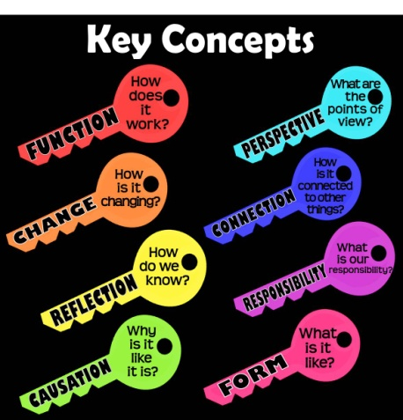


Barriers to Learning
READING | LISTENING | WITH INSTRUCTIONS | WRITING
VOCABULARY | KEY CONCEPTS | REMEMBERING | PHYSICALLY
Notes:
Pupils struggle with……
Can be more than one problem due to the co-morbidity of special needs – a continuum

Slide 15
Research suggests…
10% of children have some form of Dyslexia
5% of children have some form of ADD/ADHD
6% of children have some form of DCD
7% of children have some form of SLCN
12% of children have some form of Optical difficulty including Scotopic Sensitivity (Irlen Syndrome)
1% of children have some form of Autistic Spectrum Disorder (ASD)
Notes:
10% of children have some form of Dyslexia →this means around 3 out of every 30 students in school may have inherent difficulties with written language, in terms of reading texts and expressing themselves in writing. They will also likely have poor working memory and organisational skills.
5% of children have some form of ADD/ADHD (Attention Deficit / Hyperactivity Disorder) →this means 1 out of every 20 students in school may have inherent difficulties with concentration - struggling to focus for 20mins without support. They will also have poor working memory, poor organisational skills and poor sleep patterns.
6% of children have some form of Dyspraxia → this means 1 out of every 20 students in school may have inherent difficulties with the acquisition and use of spoken language and fine motor skills (seen mainly in handwriting). They may also struggle with everyday adult language, understanding abstract concepts, interpreting different opinions, taking part in group work.
7% of children have some form of SLCN (Speech, Language and Communication Needs) →this means 1 out of every 20 students in school may have inherent difficulties with the continued acquisition, understanding and expression of spoken language.
12% of children have some form of Optical difficulty including Scotopic Sensitivity (Irlen Syndrome) →this means 2 out of every 20 students in school will have inherent difficulties with seeing or processing certain types of visual information – particularly when there is glare, high contrast, complex patterns (including text) and colours.
1% of children have some form of Autistic Spectrum Disorder (ASD) →this means 1 out of 3 – 4 classes in school will have a student with substantial, inherent difficulties with the understanding of abstract concepts, empathy, interpretation of different opinions, group work and imaginative writing.

Slide 16
Speaking and Listening
Pupil A tell Pupil B about your holiday without using the letter ‘t’.
Pupil B tell Pupil A what you would like to do if you were a millionaire without using the letter ‘n’.

Slide 17
Copy the date and L.O
2017年9月5日
讨论从垂直平面复制到水平面的困难。
Notes:
Discuss the difficulties when copying from a vertical to a horizontal plain.

Slide 18
Spellings
Bourgeoisie
Chamois
fuchsia
facetious
discombobulated
queuing
diarrhoea
onomatopoeia
Baccalaureate

Slide 19
Write a paragraph about your holiday
The Rules…
•Write with your non-writing hand.
•Do not use any punctuation.
•Do not use any words over three syllables.
•Count to five before writing any two-syllable words.
•Count to three before writing ‘p’, ‘q’, ‘d’ and ‘b’.

Slide 20
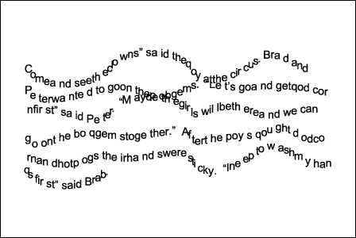
Reading

Slide 21
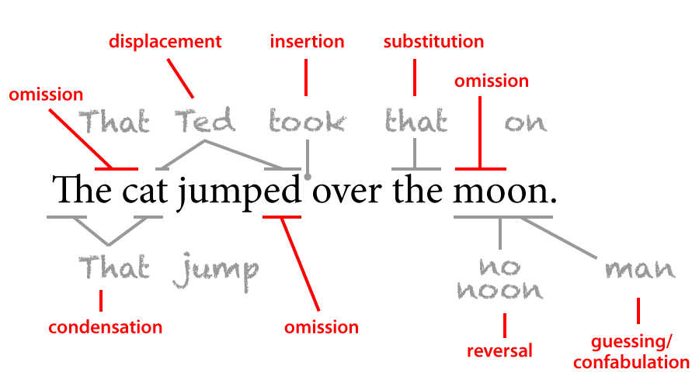
Reality

Slide 22

Autistic Spectrum Disorders
The SPELL framework was developed by The National Autistic Society’s schools and services to understand and respond to the needs of people with ASD.
SPELL stands for:
Structure
Positivity
Empathy
Low Arousal
Links
Notes:
Structure – Students with ASD need a very clear structure in terms of timetable, predictable lesson routines, clearly demarcated transitions during the day etc.
• Positivity – Students with ASD will have often found themselves regularly in conflict with the culture and systems of the school environment – and are likely to have encountered much advice starting with “you can’t” , “you shouldn’t” etc. They need positive targets and language for behaviour and learning expectation.
• Empathy – Staff working with students with ASD need to constantly place themselves in each student’s shoes because they see the world differently and therefore act differently. Staff need to regularly meet and ‘de-brief’ each other act as a way of reflecting and checking each other’s emotions.
• Low Arousal - The approaches and environment need to be calm and ordered in such a way so as to reduce anxiety and aid concentration. Lighting, volume, background noise all need to be considered.
• Links – A consistent approach between all staff and, as much as possible, with families is needed to provide security for the students

Slide 23

Based on the TEACCH model, a specific ASD classroom should be set-up as follows:
• Dimmed / natural lighting – no flickering lights!
• Pastel coloured display boards – no bright contrasts.
• No ‘busy’ displays or posters around the whiteboard.
• Minimal background noise.
• Clearly defined working areas for each student.
• A visual / colour coded timetable - either on a wall or on each desk.
• A daily schedule including times of transitions – either on a wall or on each desk. Include a digital clock on the wall to help students track time and prepare for changes.
• A simple, positive rules / behaviour targets list - either on a wall or on each desk.
• A ‘job list’ for each lesson, either for each student or for the entire group – put up at the beginning and tick as you go.
• Secluded, quiet working area/s for ‘time out’ or ‘independent study’.
• Clearly labelled areas for equipment, books, students to put their belongings.
Elements of this approach can be adopted in mainstream classrooms to make them more ‘ASD-friendly

Slide 24
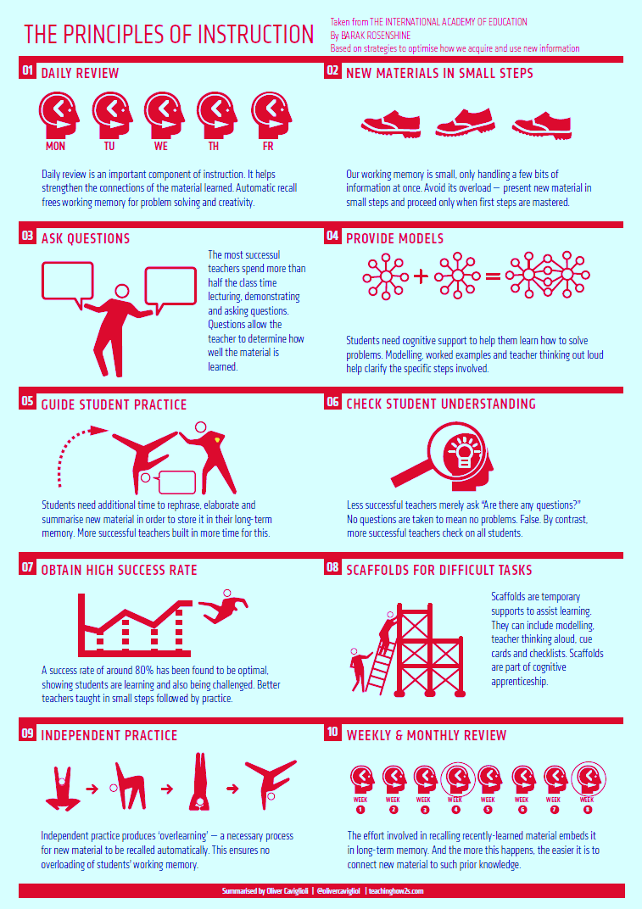
Barak Rosenshine
How long is it before you forget what you have been told?
Ask Ebbinghaus

Slide 25
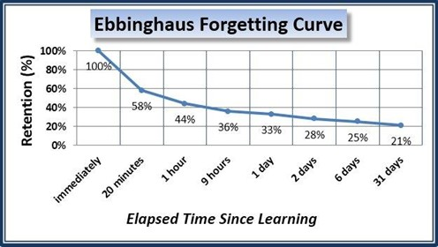
Ebbing who?
Notes:
Interesting to note that after a week only a quarter of the information has been retained

Slide 26
At our school, pupils’ SEND requirements are separated into eight areas of need. The table below displays the percentage of pupils with each need per year group.
 | Year 7 | Year 8 | Year 9 | Year 10 | Year 11 | Year 12 | Year 13 | Total students
Specific learning difficulties | 11/202= 5.4% | 10/162= 6.1% | 15/166= 9% | 13/`151= 8.6% | 3/145= 2% | 0% | 2/68= 2.9% | 54
Cognitive and learning difficulties | 17/202= 8.4% | 0% | 2/166= 1.2% | 5/151= 3.3% | 1/145= 0.6% | 0% | 0% | 25
Social, emotional and mental health difficulties (SEMH) | 8/202= 3.9% | 14/162= 8.6% | 5/166= 3% | 13/`151= 8.6% | 11/145= 7.5% | 1/82= 1.2% | 0% | 52
Speech, language and communication needs | 0% | 2/162= 1.2% | 0% | 3/151= 1.9% | 3/145= 2% | 0% | 1/68= 1.4% | 9
Sensory impairment | 1/202= 0.4% | 1/162= 0.6% | 0% | 1/151= 0.6% | 2/145= 1.3% | 0% | 0% | 5
Physical and medical needs | 2/202= 0.99% | 1/162= 0.6% | 3/166= 1.8% | 1/151= 0.6% | 1/145= 0.6% | 1/82= 1.2% | 0% | 9
Autistic Spectrum Disorder (ASD) | 0% | 0% | 0% | 3/151= 1.9% | 0% | 3/82= 3.6% | 2/68= 2.9% | 8
Other | 7/202= 3.4% | 6/162= 3.7% | 4/166= 2.4% | 4/151= 2.6% | 2/145= 1.3% | 2/82= 2.4% | 0% | 25
Total | 46 | 34 | 29 | 43 | 23 | 7 | 5 | 187

Slide 27
EAL learners and New Arrivals to the UK
Strategies to support new arrivals/early stage learners of English in the mainstream classroom
NB: these pupils are regular learners who need time & support to access & understand, they do not have learning difficulties.
Seat next to supportive pupils who can provide good models of language and behaviour
write key words and phrases on the board
Use plenty of visuals to contextualise the learning.
Demonstrate and model.
Repeat and show individually.
Encourage the use of a dual language dictionary (if literate in home language)
Begin with closed questions to enable single word responses
Expect that she/he may be silent
Use writing frames
Notes:
I would like to add, “Place in middle sets and not bottom sets as they need good models of language and learning/ behaviour.”
What about advanced EAL learners who need support, including born & brought up here, fluent speakers, quite literate but requiring support with developing formal/ academic English? Is this an issue for Cox Green?

Slide 28

ADHD Non-Medical Routes → Teaching Approaches
Have clear routines that mark the start and end of a lesson – standing behind chairs, fixing uniforms etc. Praise students for keeping to it.
Decide whether to line-up outside or come straight in to a task on arrival – both have benefits, both can be counter-productive.
Try to settle students with a ‘do now’ activity on immediate entry to the class - this doesn’t necessarily have to be the most mentally challenging – can be a routine such as copying down the date, title, B.Q
Discreetly build in ‘movement breaks’- give them classroom-based errands, allow them to go to a nearby toilet etc.
Use checklists and ‘mini-rewards’ on completion to structure your lesson.
Try to avoid text-heavy worksheets and Smart board presentations. → use visuals but keep them separate from text.
Place the student somewhere in which eye contact with information sources is easy to maintain.
Position near good role models and/or students who will support them in repeating information they may miss.
Avoid automatically sitting them at the front, as this can be seen as a punitive measure.
Try to sit them away from areas where students walk past, near door windows, near colourful displays etc.
Consider whether being seated near an outside window helps / hinders them (some students benefit from this because it’s a better alternative than switching their attention to peers!).
Encourage eye contact.
Keep language simple – one or two parts.
Ask them to repeat information back.
Repeat calmly and positively if needed.
Say what you want rather than what you don’t want.
Use language of expectation “thank you” rather than “please”.
Give advance warning of consequences of poor choices.

Slide 29

Anxiety Disorders
In the classroom… with hyperactivity
The young person may rush somewhat carelessly through work to ‘get it done’ and achieve praise. Provide them with some specific criteria around the quality of their work as well as quantity. i.e. “I want you to write in full sentences…” and/or “I want you to use the following key words in your writing…”
When establishing boundaries / reminding of rules, focus on what you what them to do rather than what you don’t want them to do.
Provide models of work that the young person should aim towards – this will also help prevent careless rushing.
Give them ‘jobs’ such as handing out or collecting in equipment to help channel their need to be active.
Allowing the young person to go for a toilet break (with a time limit of 3 minutes) may offer a discreet way for them to gather their emotions / calm down.
If they go off on a tangent, use phrases such as “Right now we are focusing on…” and “First let’s answer / complete this… Then we will…”
In the classroom…with perfectionism
Gently put in place time limits around pieces work – coach the young person around what ‘can be done’ in a given time limit not what ‘should be done’.
Provide examples of finished products of work – of different quantities and qualities – providing a variety of positive points about them. Set specific targets around when a piece of work is ‘good enough’ rather than ‘perfect’.
Give specific praise – “I like what you did with…” rather than general praise. Include within this any praise that can be given for overcoming / moving on from mistakes (this could be as simple as crossing something out without ripping out the page).
Show examples of your own mistakes in piece of work to normalise it.
In the classroom… with distraction
Provide homework instructions on a written post-it. Keep them simple and step-by-step.
Spend some time 1-to-1 to check understanding of task instructions – ask them to tell (or show) you what they’re meant to be doing rather than just repeating yourself.
Gently provide a specific, visible time limit to tasks – possibly even using an egg timer or whiteboard timer (this will benefit the whole class).
Allowing the young person to go for a toilet break (with a time limit of 3 minutes) may offer a discreet way for them some ‘take up time’ on the task ahead
In the classroom…withdrawn
Try to encourage them to contribute to class discussion through ‘easy win’ questions focusing on what, where, when rather than how, why. This may help build up their trust and confidence.
Use the ‘language of choice’ if they are being resistant / defiant – giving guidance / forewarning on the consequences of those choices.
Give specific praise – “I like what you did with…” rather than general praise.

Slide 30

Attachment Disorder
Allow regular check-in time to key adult/ secure base. Differentiate according to developmental (not chronological) age.
Do not insist on eye contact.
Be sensitive to possible emotive curriculum content.
Keep your voice and body language grounded and calm at all times.
Present the pupil with two or three choices, rather than engaging in control battles. Offer opportunities for reparation as close to the incident/conflict as possible.
Provide time for the students to de-escalate their feelings and then discuss calmly. Use ‘we’ not you
Use language that builds a pupil up
Give prior warning and preparation if there are changes to routine, or transitions coming up.
Use “Let’s” rather than “Don’t”.
Notes:
Allow regular check-in time to key adult/ secure base. This needs to be on a regular basis – once is not enough it needs to be built into both yours and students daily/weekly routine.
Differentiate according to developmental (not chronological) age.
Do not insist on eye contact. This does not mean that a child is being rude or not listening. It is a very difficult thing to do. Try and do this firstly with someone you know and then with a new acquaintance. How do you feel?
Be sensitive to possible emotive curriculum content. We don’t always know how emotions and memories can be triggered. By knowing our students we will not bring subject content which is difficult for them to hear into the lesson content.
Keep your voice and body language grounded and calm at all times. Students can see weakness very quickly and they pounce on this very quickly.
Present the pupil with two or three choices, rather than engaging in control battles. Once the options have been given, don’t negotiate be firm on what you have offered.
Offer opportunities for reparation as close to the incident/conflict as possible. Provide time for the students to de-escalate their feelings and then discuss calmly. Use ‘we’ not you
Use language that builds a pupil up, such as ‘practising’ and ‘getting stronger at’.
Give prior warning and preparation if there are changes to routine, or transitions coming up. Students who are very anxious struggle with change, provide them with as much warning as you can and offer support for those changes.
Use “Let’s” rather than “Don’t”.

Slide 31
Every teacher is a teacher of SEN
Useful resources
www.read-able.com
www.humansnotrobots.co.uk
www.dyslexiaaction.org.uk
www.dyspraxiafoundation.co.uk
www.suepalmer.co.uk
www.tts-group.co.uk
www.ldalearning.com
www.talk4writing.co.uk
www.specialeducationalneeds.co.uk Douglas Silas
www.eyecanlearn.co.uk
www.visuallearningforlife.com

Slide 32
We have a duty of care and legal responsibility to teach children with SEN
We will use differentiation and Quality First Teaching which looks at the barriers to learning and a graduated approach.
All children are unique
Thank You
Notes:
Twilight on ‘Setting the priorities for our students with EHCP and EAL and sharing strategies for lessons to support these students effectively’ – 25/09

